Slide 1
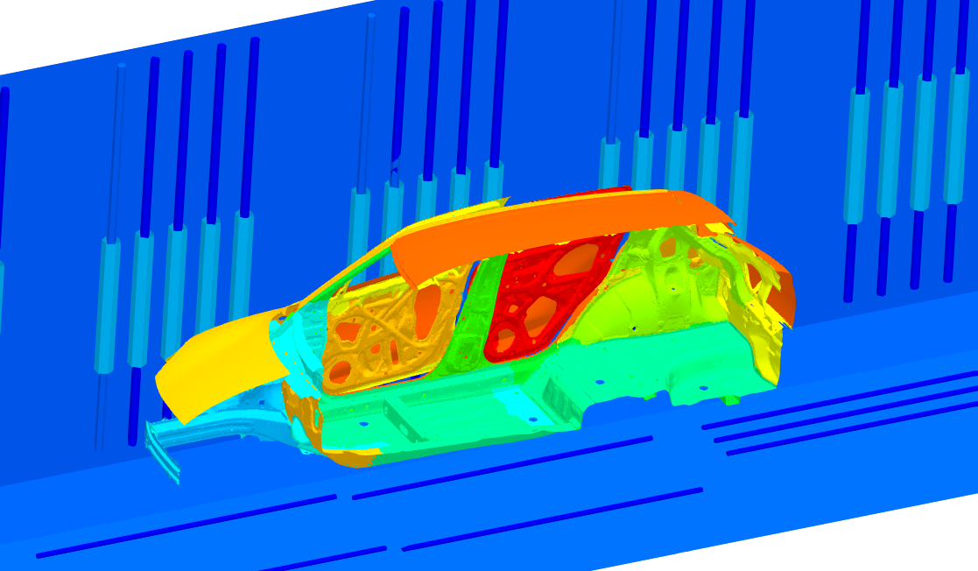
EDESFEM
Numerical Analysis Software
Specialized for Electrodeposition Coating Simulation

Slide 2
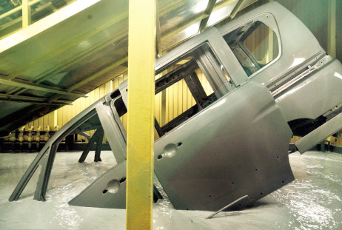


What is Electrodeposition (ED) ?
Most widely-used anti-rust basecoat methods for various metal products
including auto carbodies.
Depositing coating film by applying direct electric current in a paint pool.
Relatively good at depositing a uniform film on bodies in complex shapes.
$$+$$
$$−$$
＋
＋
Paint
Anode
Cathode
http://n-link.nissan.co.jp/

Slide 3

Importance of ED
Inspections of the safety and structural health of cars (e.g., crash tests) are usually performed with new cars without corrosion.
However, corrosion significantly reduces the strength and stiffness of a car in reality.
In other words, corrosion can easily spoil the value of the inspections with new cars.
https://wd40.pk/
$∴$ ED is critical to the safety and structural health of carbodies.

Slide 4
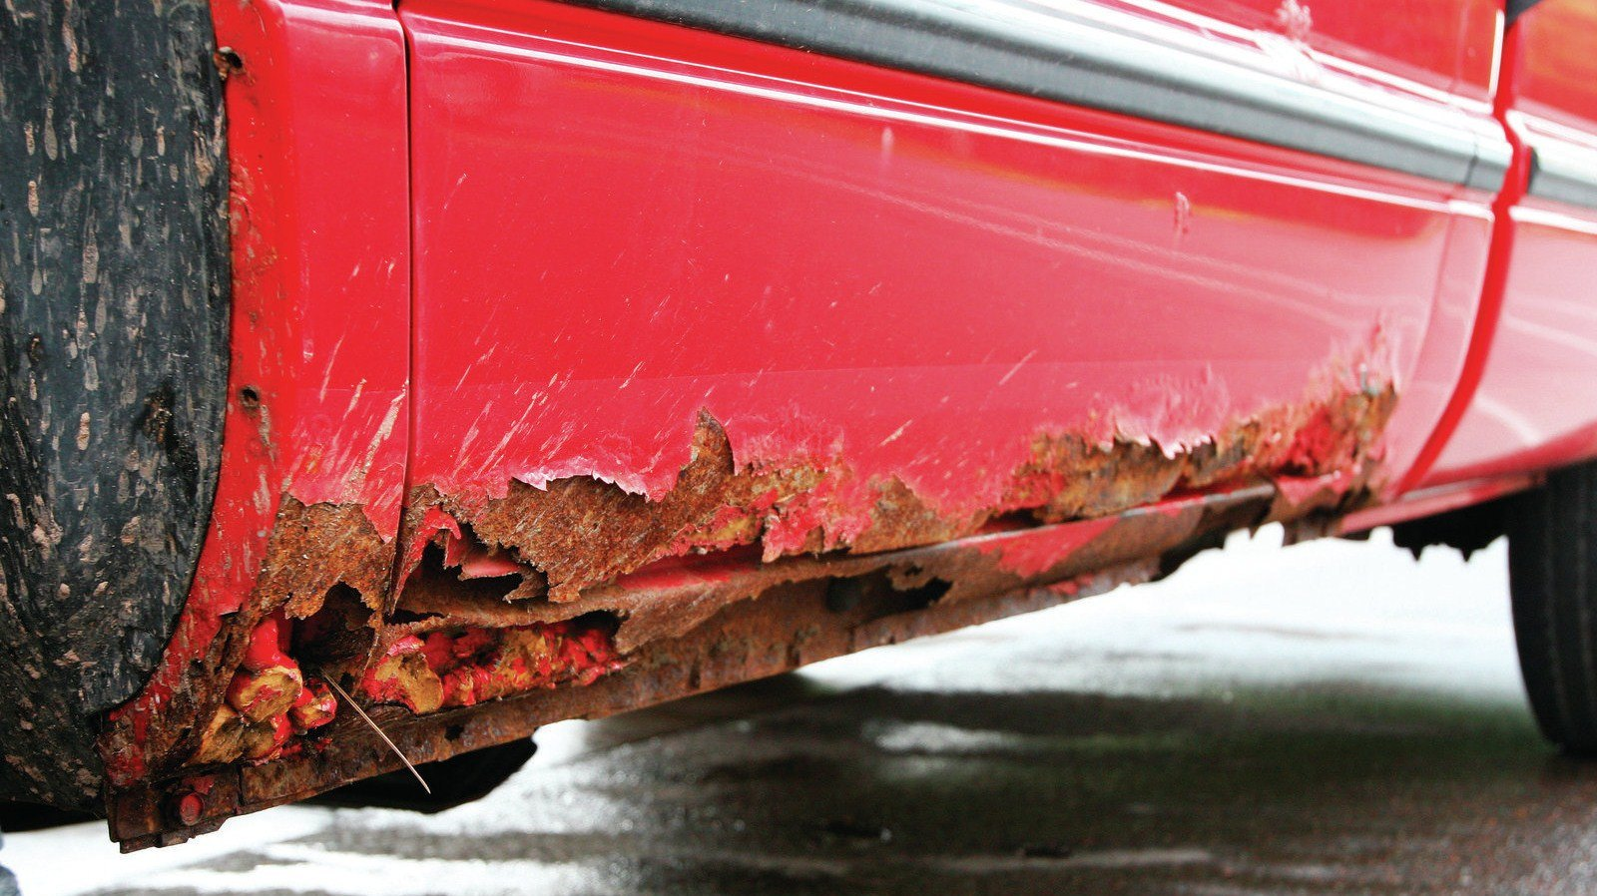
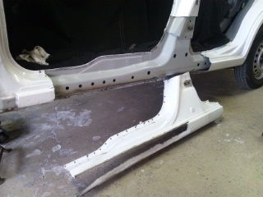
Impact of ED process on carbody design
Undercarriages are exposed to severe corrosive environments.
(It is even more severe in environments with seawater or snow-melting chemicals.)
Thus, it is necessary to ensure the ED film thickness is above minimum over the entire surface of the undercarriages.
Some undercarriage parts (e.g., side sills) have bag-like complex structures with laminated plates, making some ED holes as the path for ED current to the inner faces is indispensable.
Side sill
https://www.goauto.ca/
$∴$ Understanding and considering the ED process, including the location and size
of the ED holes, is essential for carbody design.

Slide 5
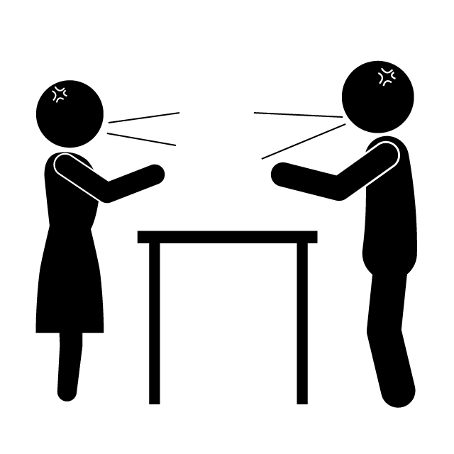
Need for ED Simulation
ED holes are essential for corrosion protection,
while they are unwanted for strength/stiffness.
Thus, the following conflict occurs in the field of carbody design.
Of course, ED simulation is also useful for pre-study of the effect of ED condition changes on film thickness, cause finding and quick improvement of insufficient deposition, etc..
More
ED holes!
Fewer
ED holes!
Corrosion Section
Strength/Stiffness Section
ED simulation can resolve such conflicts without any seeds of future trouble
and lead to the optimal carbody design.

Slide 6
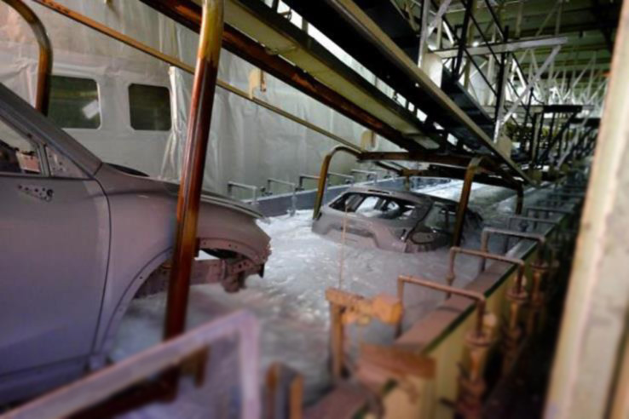
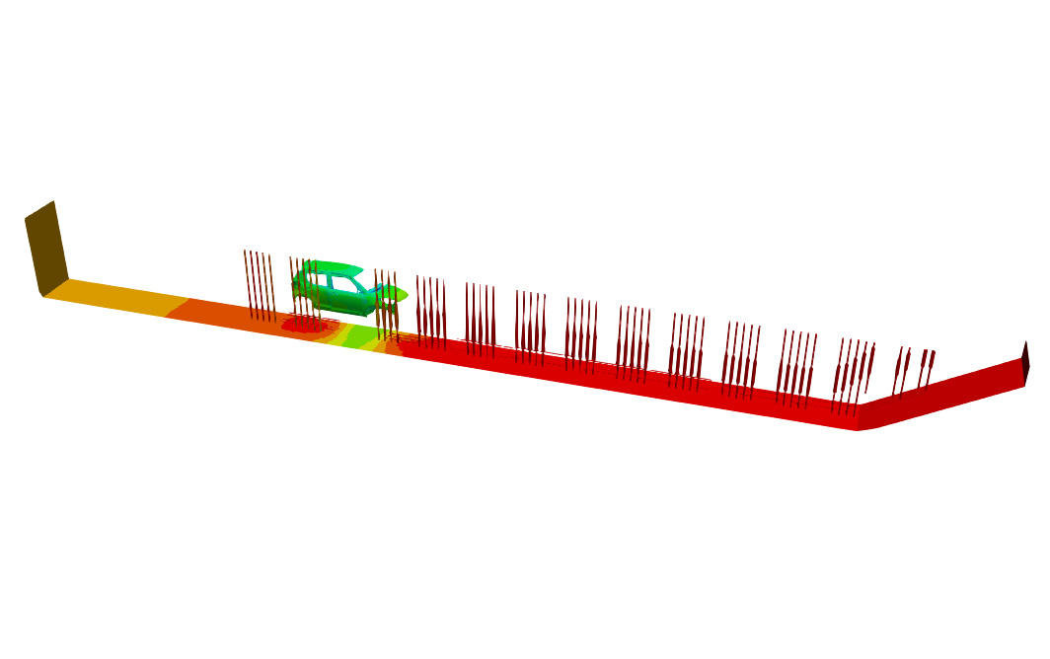
What is ED Simulation?
Actual ED Line
ED Simulation
Paint Pool
Carbody with Motion
Electrodes (Anodes)
are reproduced in a computer.
Paint
Pool
Carbody
w/ Motion
Electrodes
(Anodes)
Total length: about 30 m

Slide 7
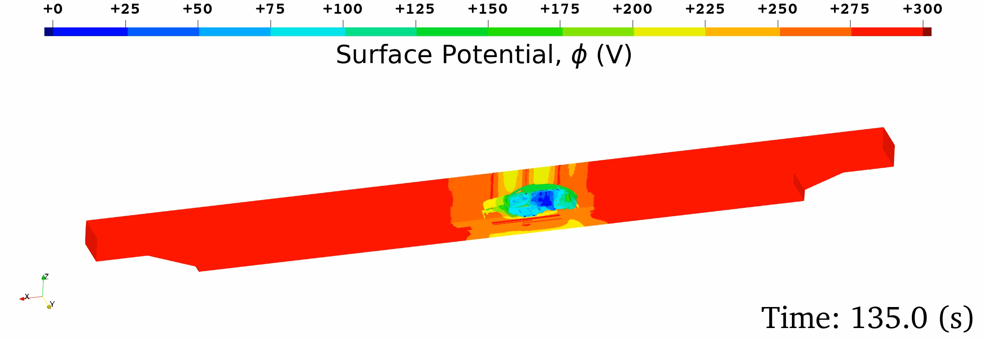
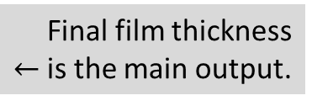


What is ES Simulation?
Governing equation:
Electrostatic Laplace equation ($∇^{2}φ=0$) in the paint pool domain.
Boundary conditions:
  Wall (insulation) BC，
  Anodic (electrode surface) BC,
  Cathodic (carbody surface) BC:
  Film resistance/growth constitutive model.
Outputs: time-histories of
  Surface potential,
  Current density,
  Film thickness
Identified via
lab experiments.
$↓$
Final film thickness
$←$is the main output.

Slide 8
4 Features of
EDESFEM

Slide 9
#1: High Accuracy with 4-node Tetrahedral Meshes
S-FEM has recently been put to practical use as a next-gen FEM.
EDESFEM adopts the edge-based S-FEM using 4-node tetrahedral meshes (ES-FEM-T4).
Despite the 4-node tet mesh,
superlinear mesh convergence rate is obtained as fast as the 2nd -order elements.
4-node tet meshes enable the analyses with a minimum number of elements,
even around ED holes, where the quadratic or Cartesian meshes lead to
a massive increase in elements.
Adopting smoothed finite element method (S-FEM) for numerical formulation
2D example
for simplicity
Standard FEM
ES-FEM
Putting
Gauss point
at each element center
Putting
Gauss point
at each edge center

Slide 10
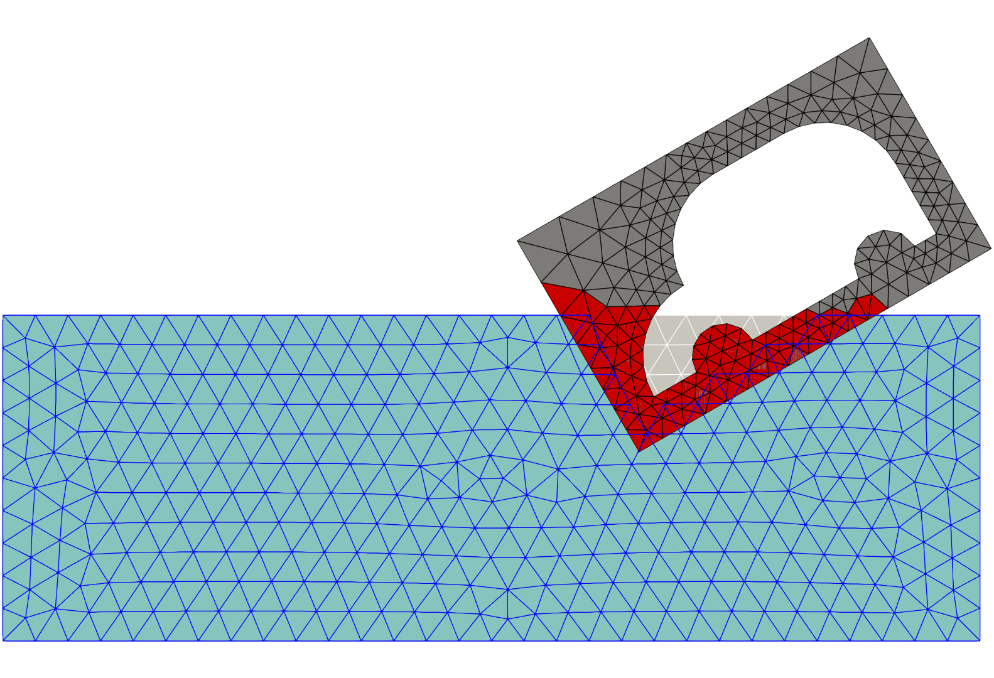
#2: Support for Moving Boundary Analysis of Multiple Bodies
The user just needs to prepare the pool/carbody meshes and motion tables for each body.
Using multi-point constraints (MPCs), meshes are automatically connected at interfaces inside EDESFEM.
Enabling moving boundary analysis of multiple carbodies with the overset mesh method
Active Elements
of Carbody Mesh
Inactive
Elements
Liquid Level
Active Elements
of Pool Mesh

Slide 11
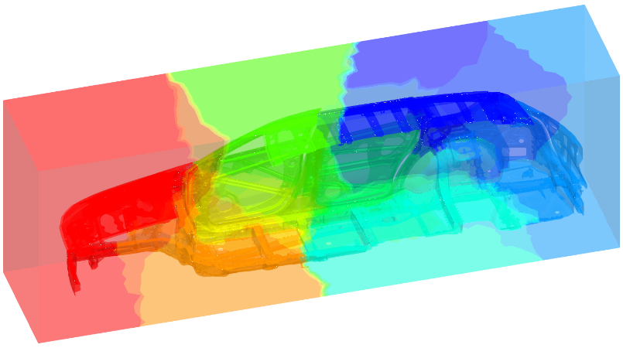
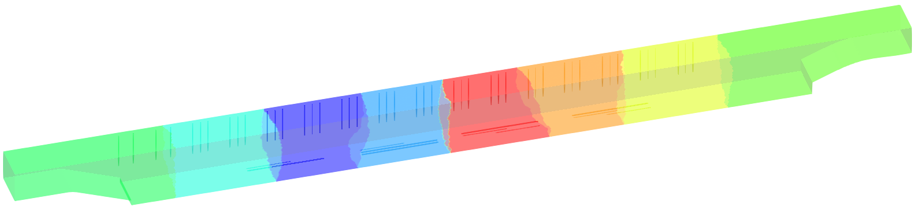
#3: High Speed with MPI/OpenMP Hybrid Parallelization
EDESFEM can use multi-core CPUs in multi-node HPC environments.
Calculation steps:
  Generating T4 mesh for pool and carbody domains.
  Partitioning and reordering each mesh with METIS.
  Preparing an input file containing the mesh filenames, boundary conditions, motion path, etc..
  Executing the program. In the case of OpenMPI:
  orterun –np 64 -bind-to socket -npersocket 1
  -x OMP_NUM_THREADS=8 -x numactl -l edesfem.bin input_file_name.ied
Accepting various HPC environments with MPI/OpenMP hybrid parallelization
Pool Mesh Partitioning
Carbody Mesh Partitioning

Slide 12
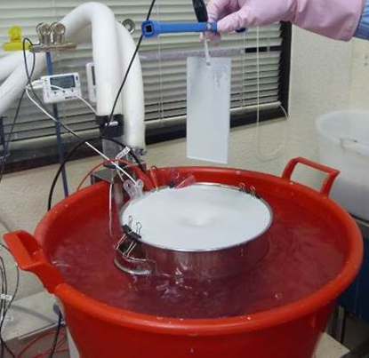
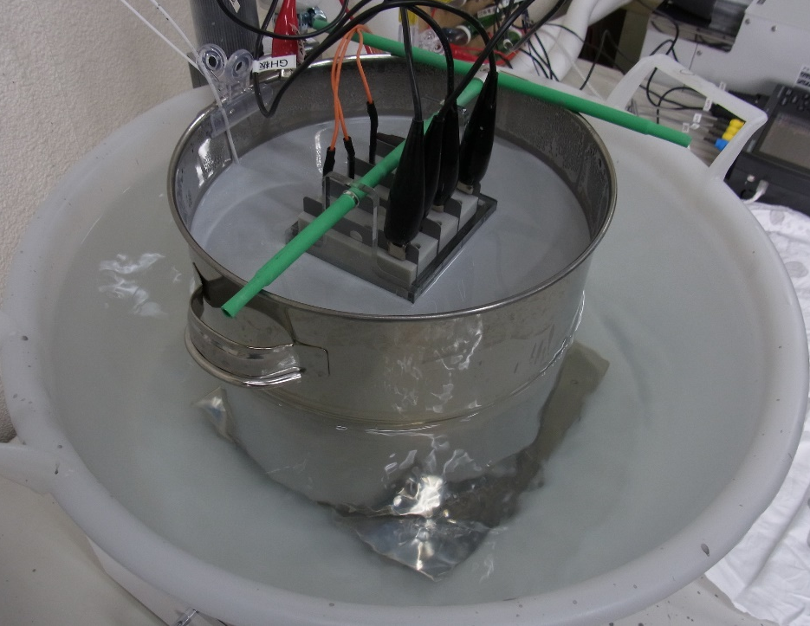
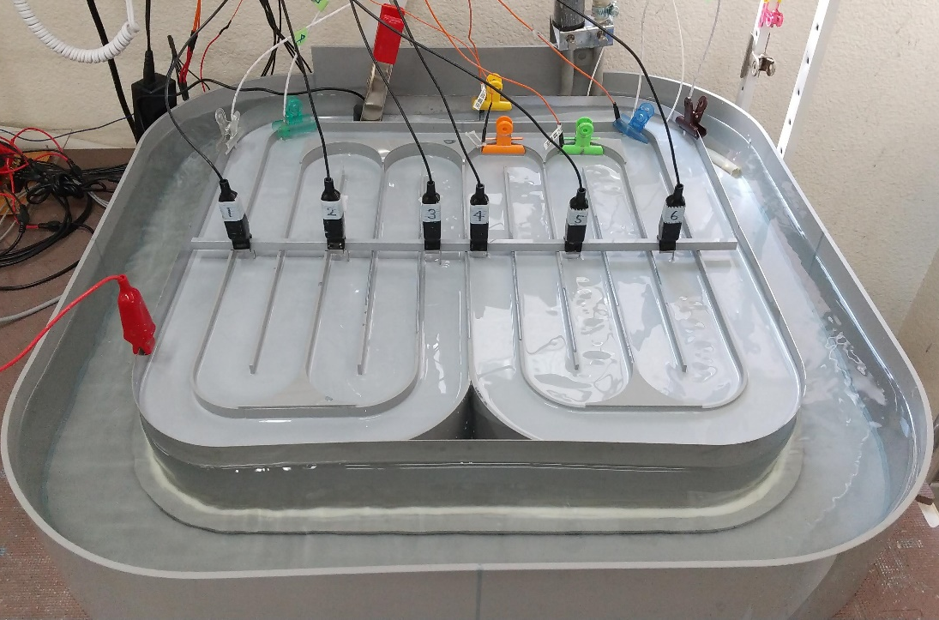
#4: Faithful Reproduction of Deposition Delay on Inner Plates
In ED, the film thickness on the inner plates inside the ED holes is important.
Detailed lab experiments are essential to incorporate the deposition behavior of inner plates into the ED numerical model.
EDESFEM implements ED numerical models obtained from the latest experimental findings.
They contribute to the reduction of non-physical “calibration” work.
Employing the latest ED numerical model based on detailed lab experiments
One-Plate Test
4-Plate Box Test
Circulating Pool Test

Slide 13
EDESFEM
Verification Example 1
4-Plate Box Analysis

Slide 14
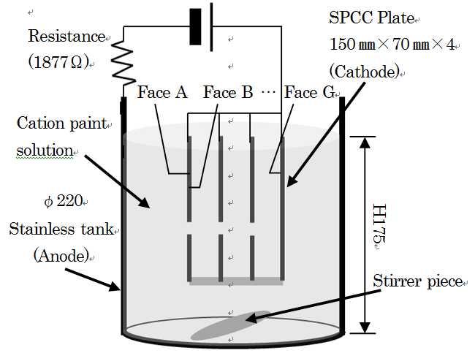
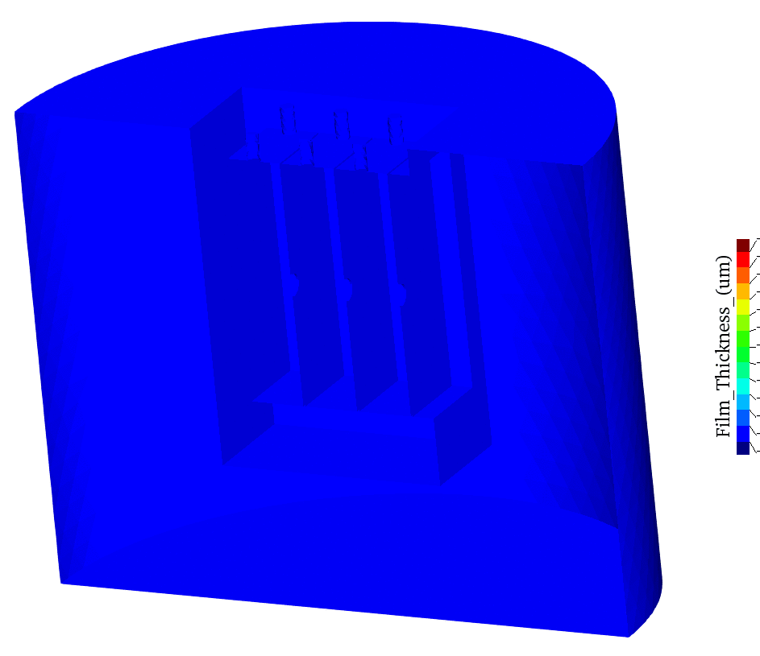
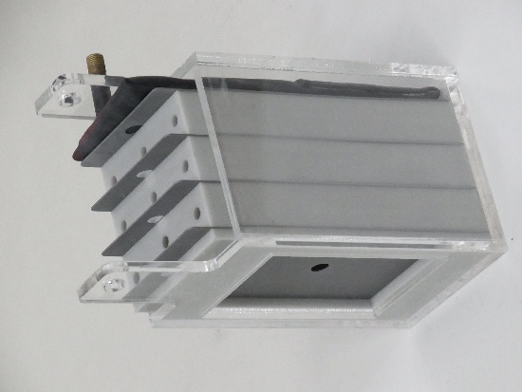
4-Plate Box Analysis
Outline
Imitating a bag-like structure such as a side sill in a carbody.
Film thickness on the innermost surface (Face G) is the most important so as to guarantee corrosion protection.
The film thickness on Face G is evaluated with 4 different density meshes
using FEM-T4 and ES-FEM-T4.
4 plates form 3 bags.
3rd bag is the most difficult to be deposited.
Photo of a 4-plate box
Time-history of film thickness

Slide 15
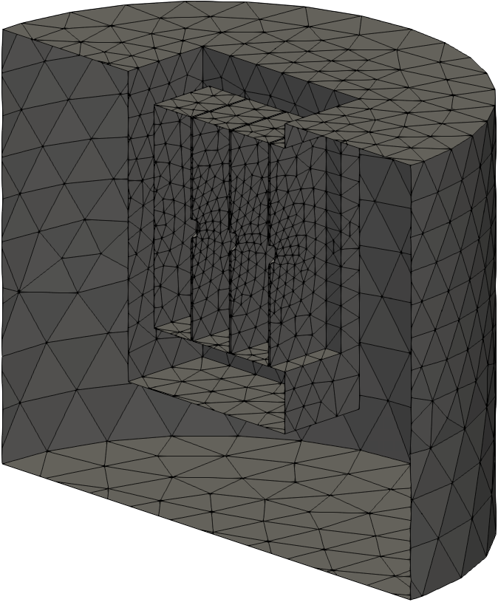
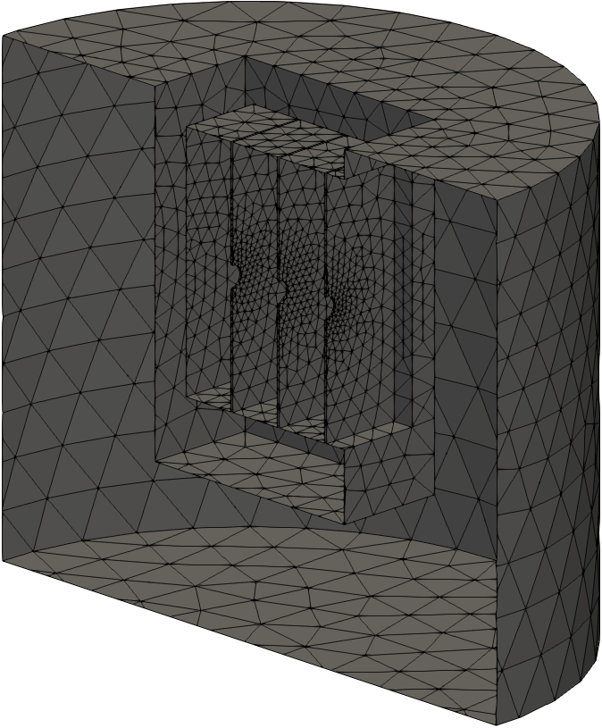
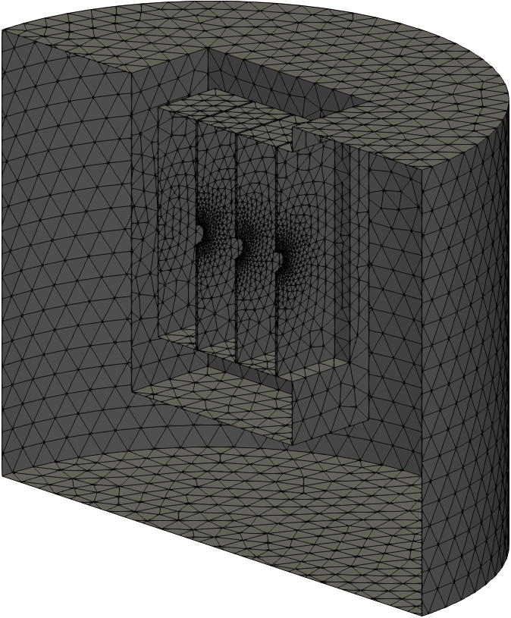
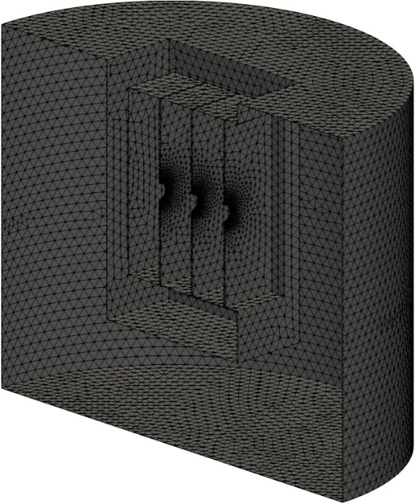
4-Plate Box Analysis
Overview
of Meshes
Only the
surface meshes
are shown.
3.2 mm Mesh
(about 31k elements)
1.6 mm Mesh
(about 65k elements)
0.8 mm Mesh
(about 169k elements)
0.4 mm Mesh
(about 716k elements)

Slide 16
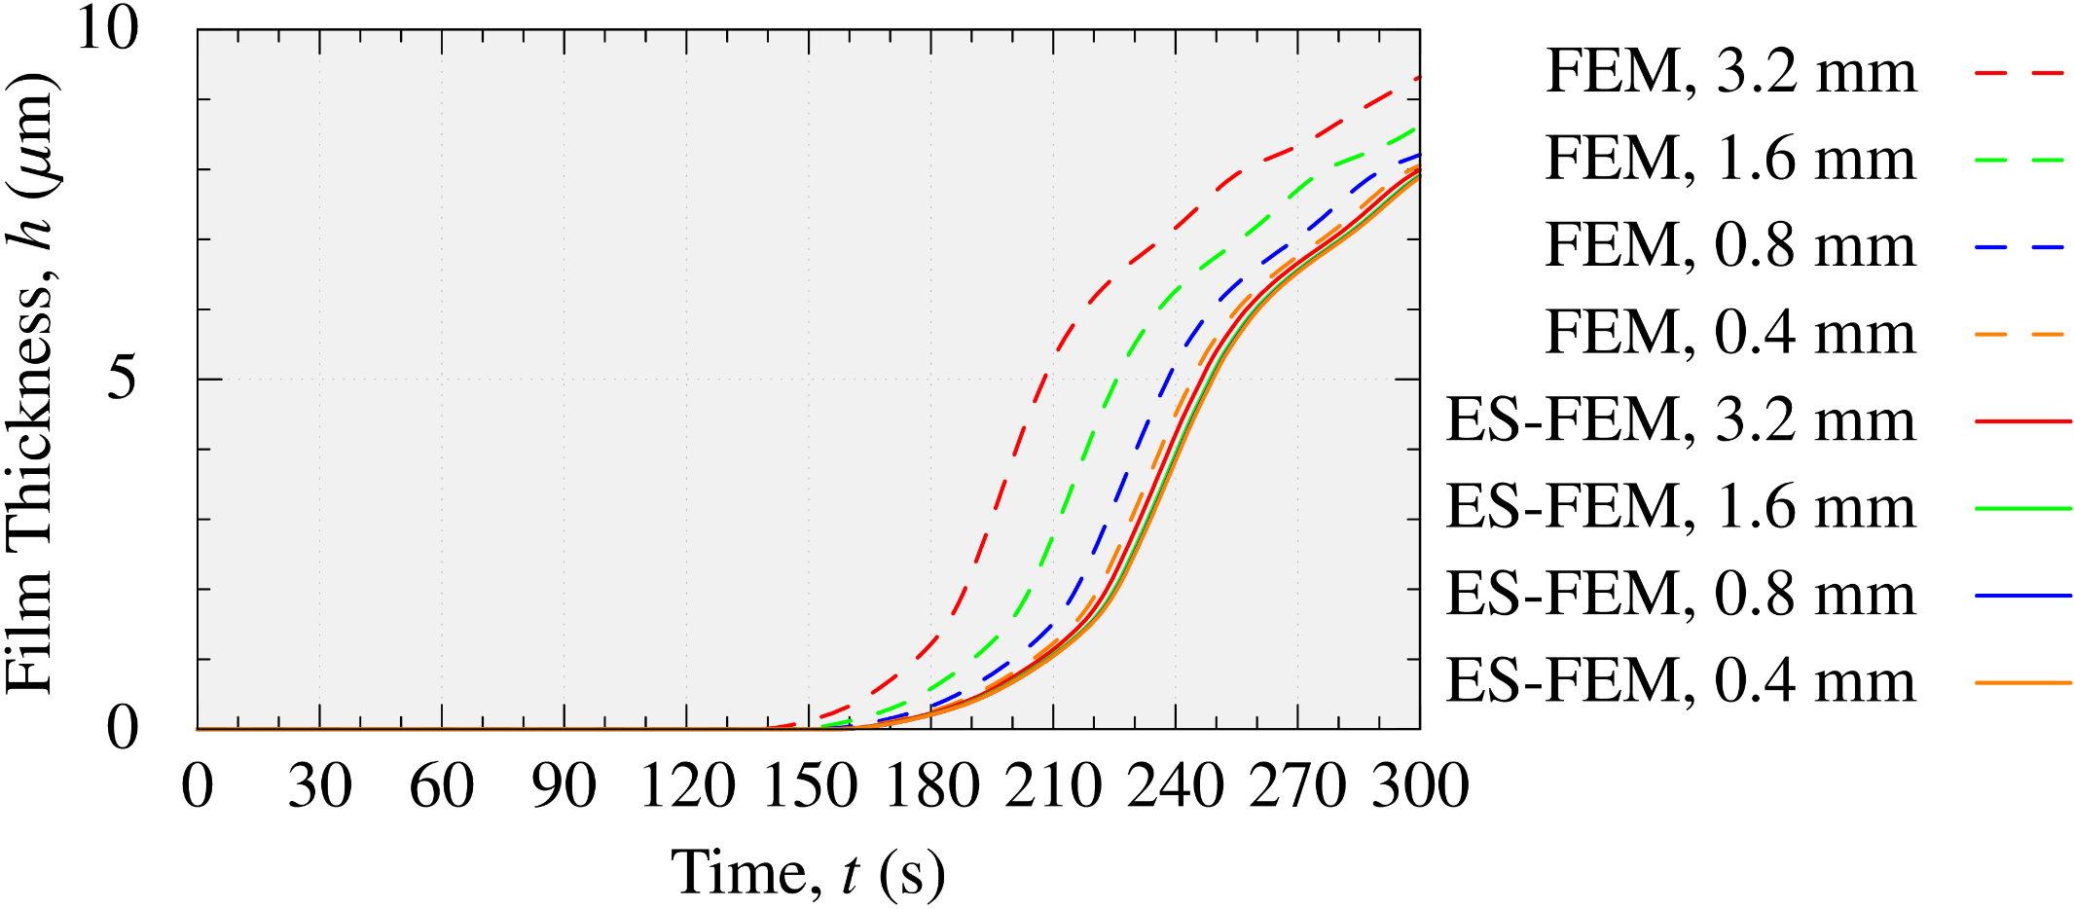
4-Plate Box Analysis
Film Thickness on Face G (innermost surface)
Mesh size
FEM results (dashed lines) have significant errors.
Meanwhile, ES-FEM results (solid lines) have no such errors
due to the fast mesh convergence rate.

Slide 17
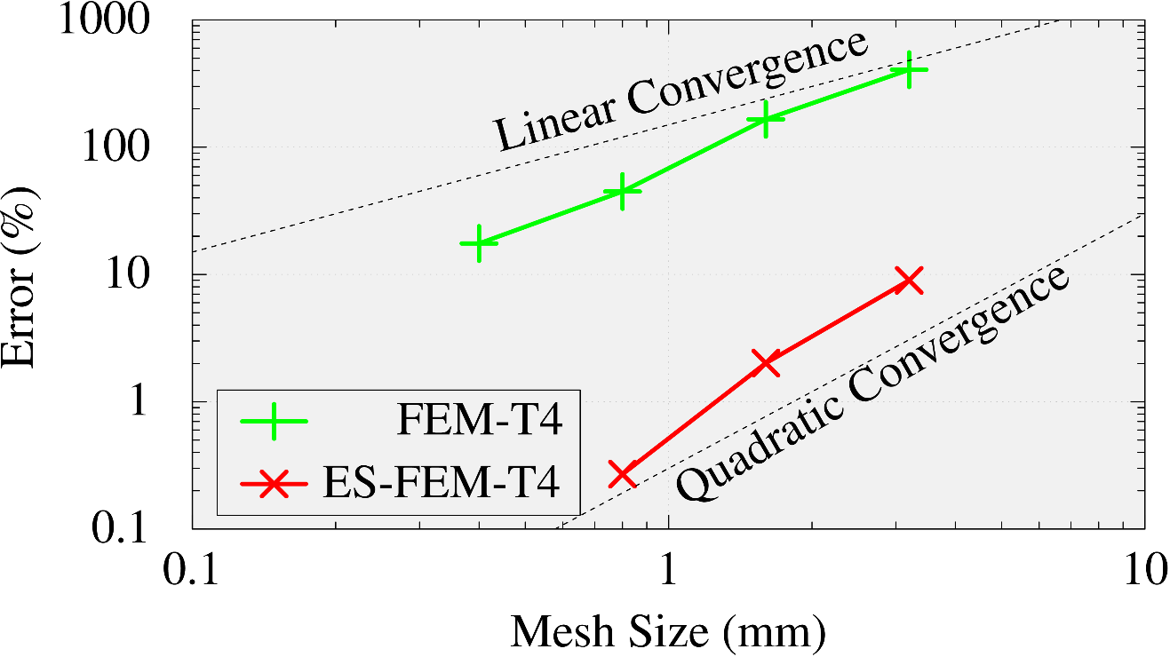
4-Plate Box Analysis
Comparison of Mesh Convergence Rate on Face G (innermost surface)
FEM-T4 shows a linear convergence.
EDESFEM (ES-FEM-T4) shows a quadratic convergence.
In Final thickness
The result of ES-FEM with the finest mesh (0.4 mm)
is used as the reference.
ES-FEM-T4 adopted by EDESFEM has a much faster mesh convergence rate than the standard FEM-T4.

Slide 18

4-Plate Box Analysis
Comparison of Calculation Time
on a PC (only 1 CPU: 16 cores of Intel i9-9960X)
With the same mesh, ES-FEM-T4 is slower than FEM by x2 $∼$ 3.
For the same accuracy, ES-FEM-T4 is faster than FEM by x4.
Mesh Size | Standard FEM (FEM-T4) | EDESFEM (ES-FEM-T4)
3.2 mm | 7 s | 10 s
1.6 mm | 8 s | 14 s
0.8 mm | 12 s | 26 s
0.4 mm | 41 s | 125 s
Comparable
Accuracy
ES-FEM-T4 adopted by EDESFEM is supremely efficient
in comparison to FEM-T4.

Slide 19
EDESFEM
Verification Example 2
Actual Line Analysis

Slide 20
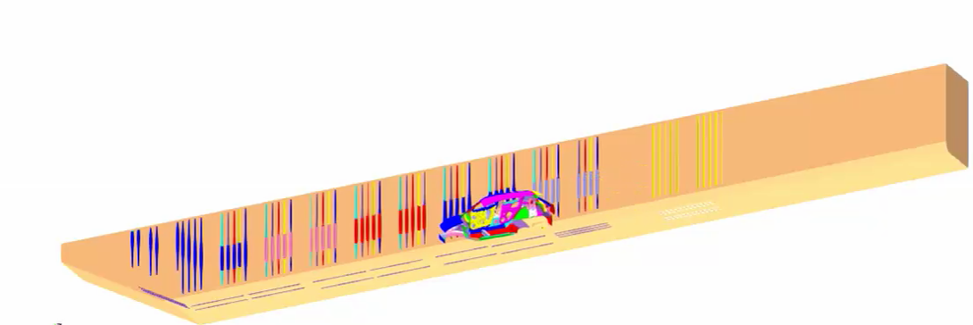

Actual Line Analysis
Outline
Half-body analysis (only right-hand side).
Entire line shape, carbody motion, and electrode conditions are faithfully reproduced.
About 1000 timesteps for 300 s (i.e., average $Δt=0.3$ s).
The film thickness distribution is evaluated with 3 different density meshes
using FEM-T4 and ES-FEM-T4.

Slide 21
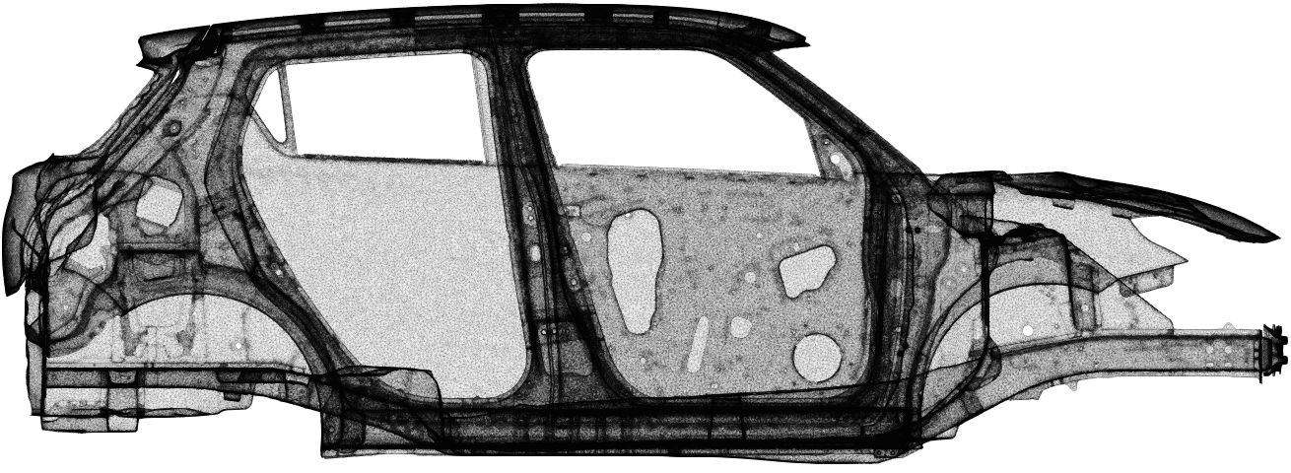
Actual Line Analysis
Overview of Surface Mesh of 10M Element Mesh
There are many ED holes around narrow spaces among plates.
Only the surface
mesh is shown.

Slide 22
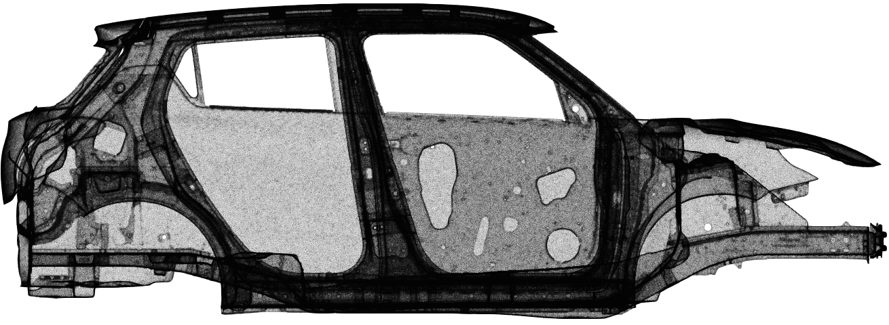
Actual Line Analysis
Overview of Surface Mesh of 16M Element Mesh
There are many ED holes around narrow spaces among plates.
Only the surface
mesh is shown.

Slide 23
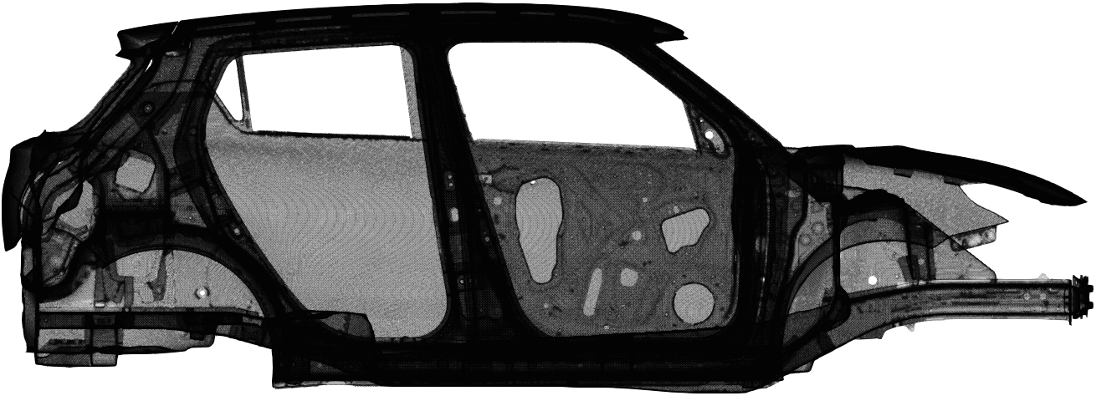
Actual Line Analysis
Overview of Surface Mesh of 51M Element Mesh
There are many ED holes around narrow spaces among plates.
Only the surface
mesh is shown.

Slide 24
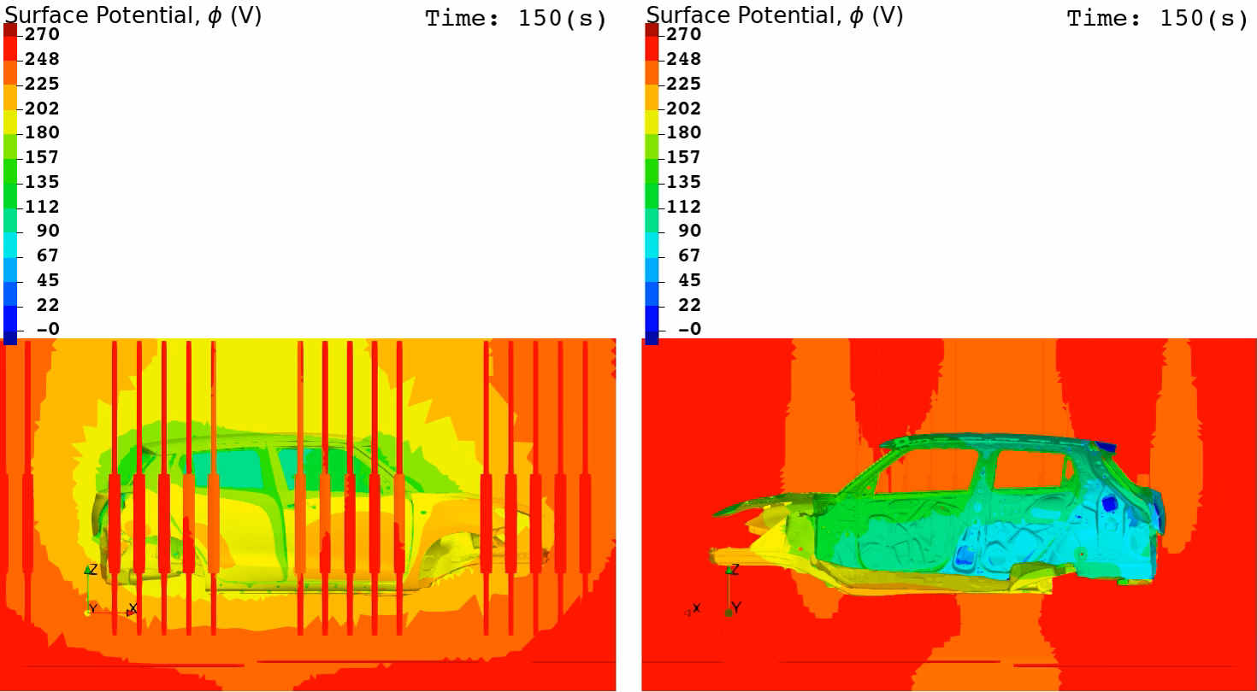
Actual Line Analysis
Animation of Surface Potential (EDESFEM with 51M Element Mesh)
Outer View Inner View

Slide 25
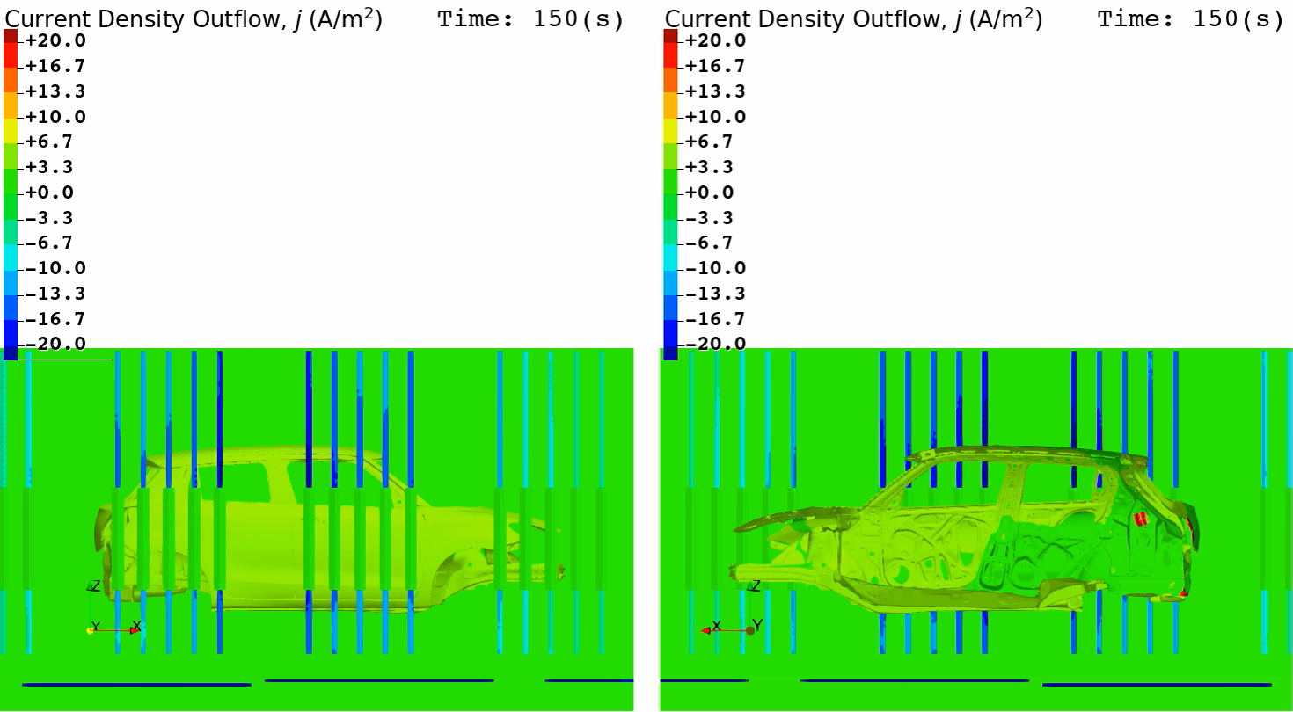
Actual Line Analysis
Animation of Current Density (EDESFEM with 51M Element Mesh)
Outer View Inner View

Slide 26
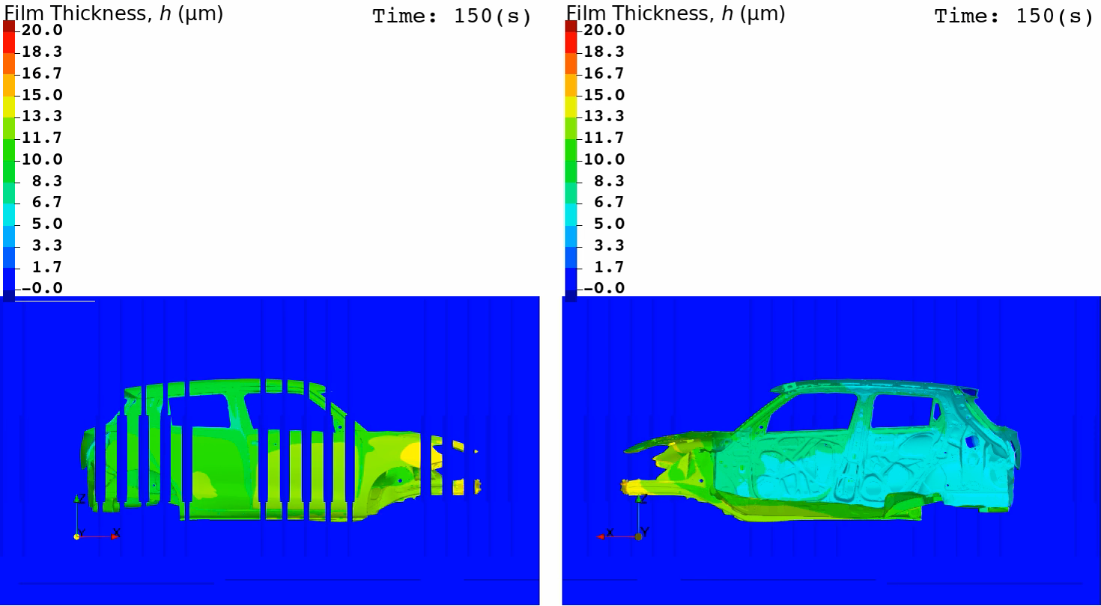
Actual Line Analysis
Animation of Film Thickness (EDESFEM with 51M Element Mesh)
Outer View Inner View

Slide 27
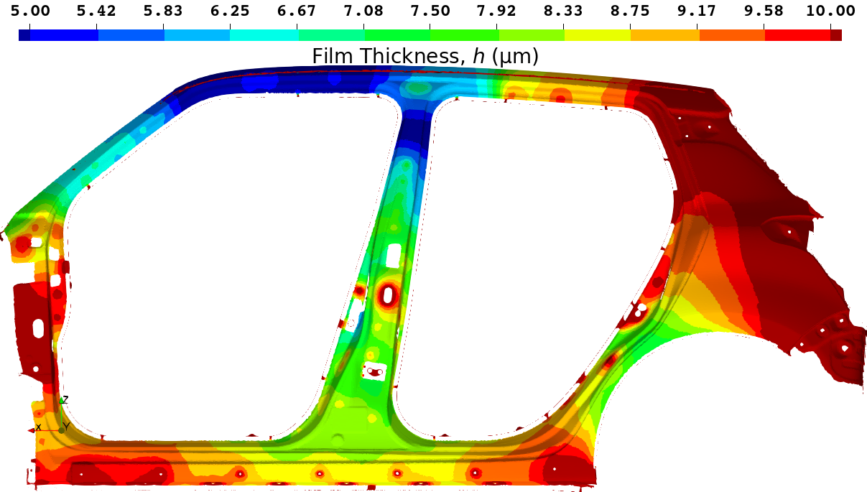
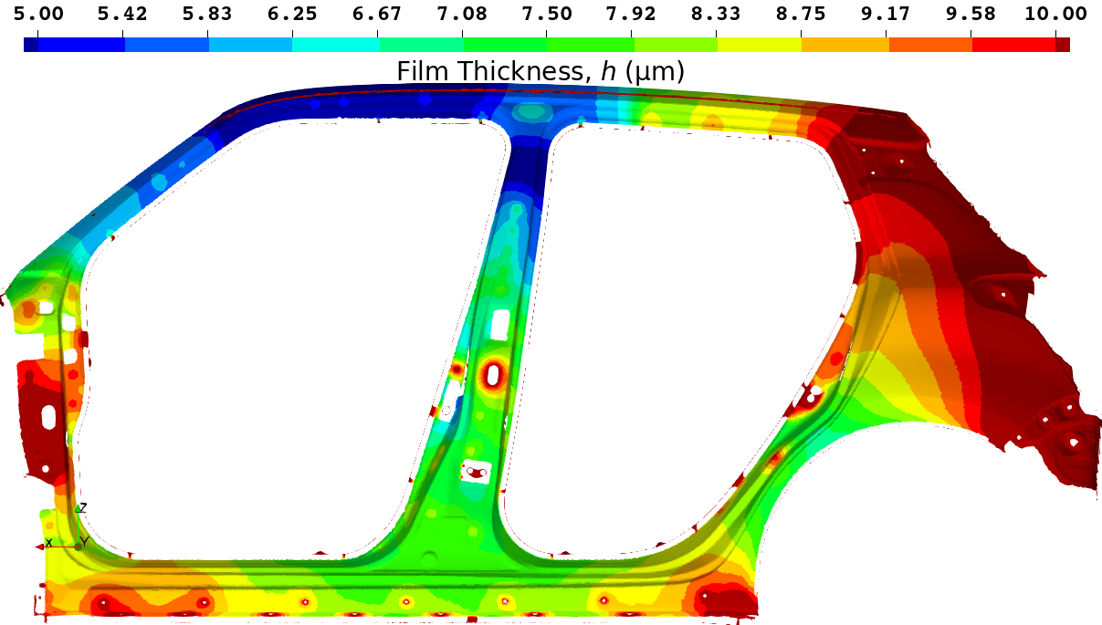
Actual Line Analysis
Film Thickness Distribution on the side sill part with 51M Element Mesh
Standard FEM (FEM-T4)
EDESFEM (ES-FEM-T4)
Reference Solution
Standard FEM shows a little thicker result.
(The center of the side sill is Yellow.)
This result is regarded as the reference solution.
(The center of the side sill is Green)

Slide 28
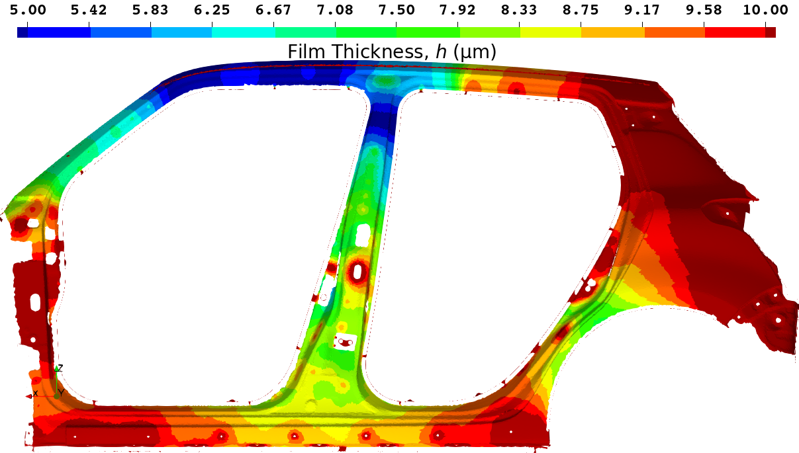
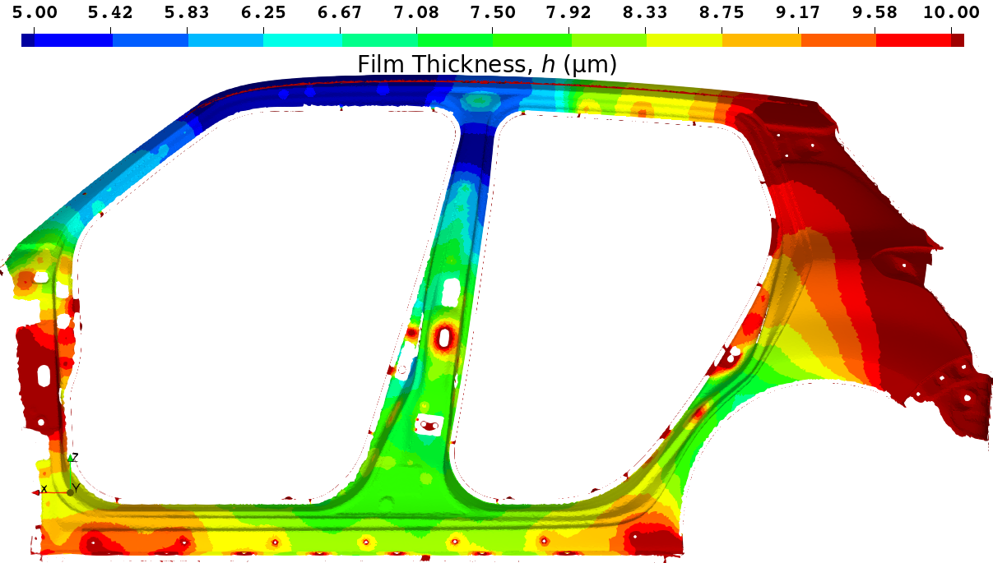
Actual Line Analysis
Film Thickness Distribution on the side sill part with 16M Element Mesh
Standard FEM (FEM-T4)
EDESFEM (ES-FEM-T4)
参照解
Standard FEM shows a much thicker result.
(The center of the side sill is Orange.)
EDESFEM shows an accurate result.
(The center of the side sill is Green.)

Slide 29
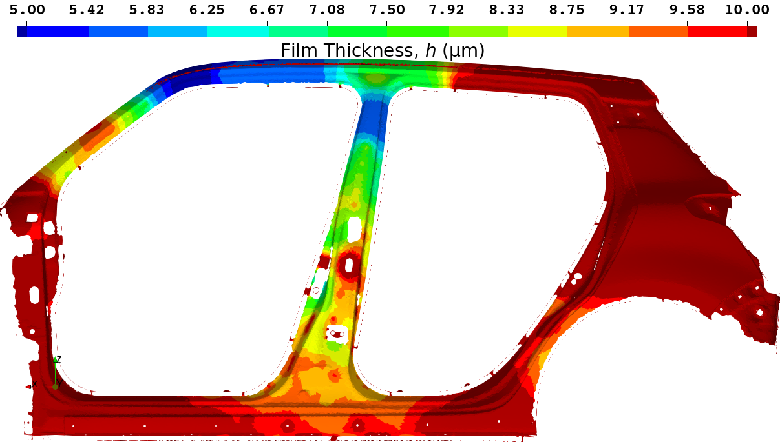
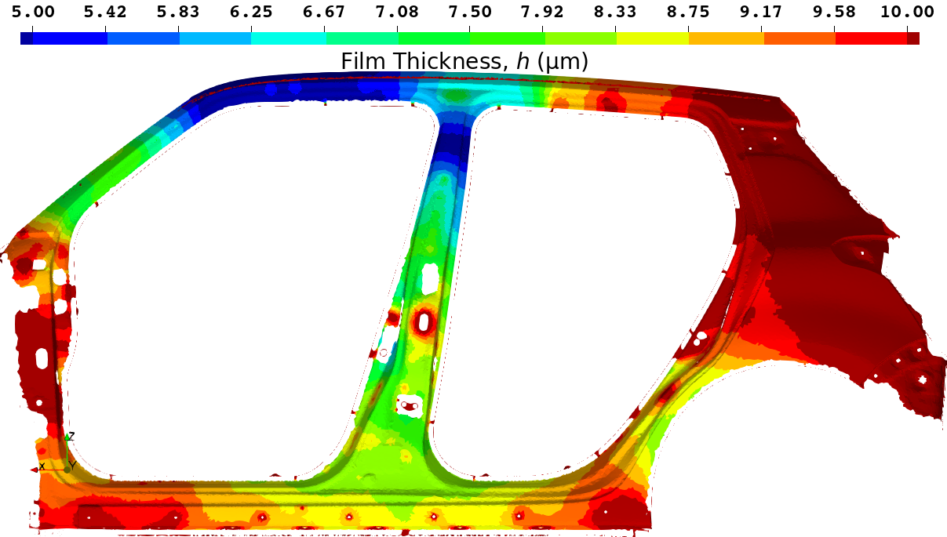
Actual Line Analysis
Film Thickness Distribution on the side sill part with 10M Element Mesh
Standard FEM (FEM-T4)
EDESFEM (ES-FEM-T4)
A comparison of the time-history
of the film thickness at this point
is shown on the next page.
参照解
Standard FEM shows a massively thicker result.
(The center of the side sill is Red.)
EDESFEM shows a little thicker result.
(The center of the side sill is Yellow.)

Slide 30
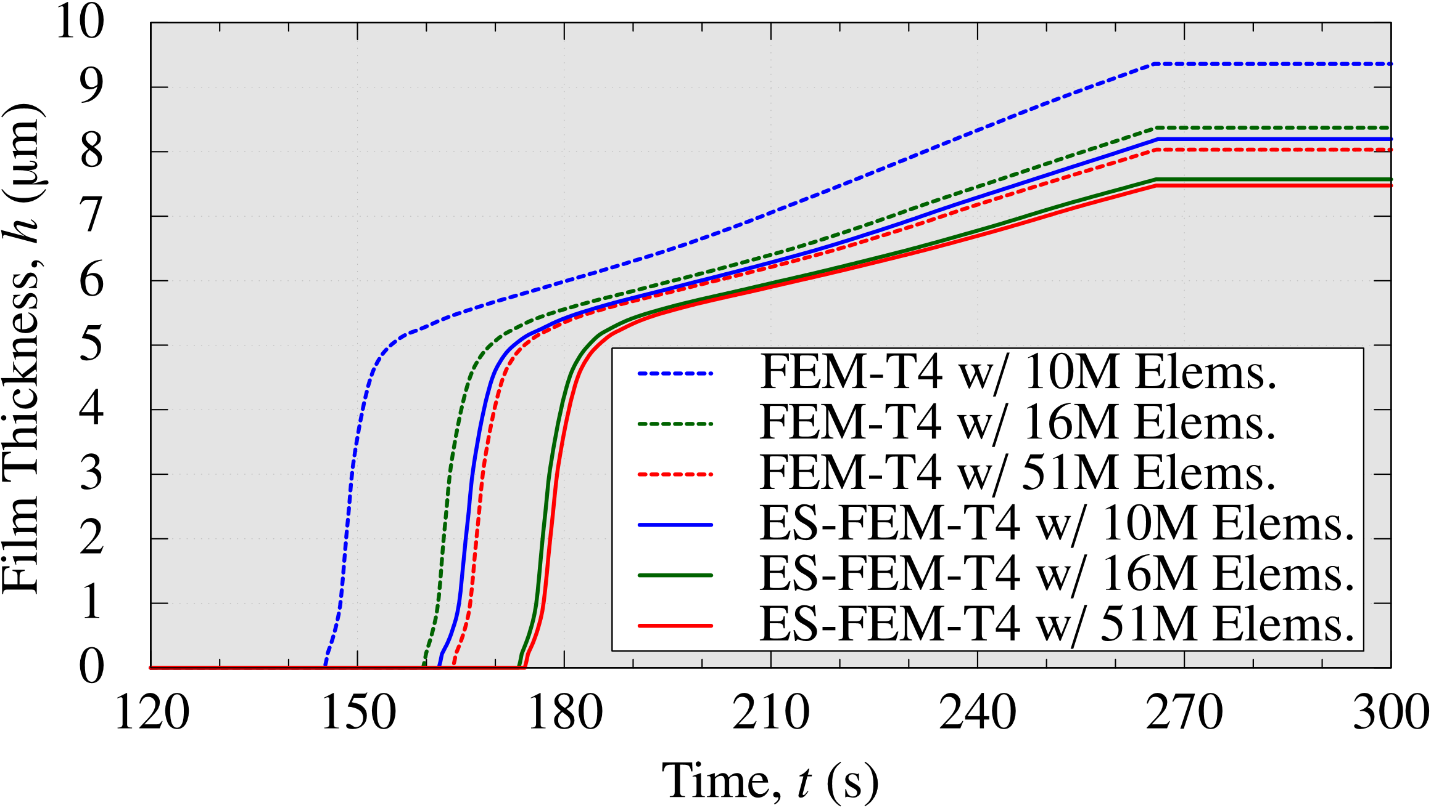
Actual Line Analysis
Comparison of Time-histories of Film Thickness at a Sample Point on Side Sill
FEM-T4 with 51M elems. and ES-FEM-T4 with 10M elems.
has almost comparable accuracy.
ES-FEM-T4 with 16M elems. gives a practically converged result.

Slide 31
Actual Line Analysis
Comparison of Calculation Time
On a cluster (64 CPUs: 896 cores of Intel Xeon E5-2680 v4 on TSUBAME3.0)
With the same mesh, ES-FEM-T4 is slower than FEM by x1.5.
For the same accuracy, ES-FEM-T4 is faster than FEM by x3.
# of Elements | Standard FEM (FEM-T4) | EDESFEM (ES-FEM-T4)
10M | 1.6 h | 1.9 h
16M | 2.3 h | 3.4 h
51M | 6.0 h | 8.5 h
An actual line analysis
of a single-body entry
takes only a few hours.
Comparable
Accuracy
For the simulations of actual ED lines with parallel computing,
ES-FEM-T4 adopted by EDESFEM is much more efficient
than FEM-T4.

Slide 32
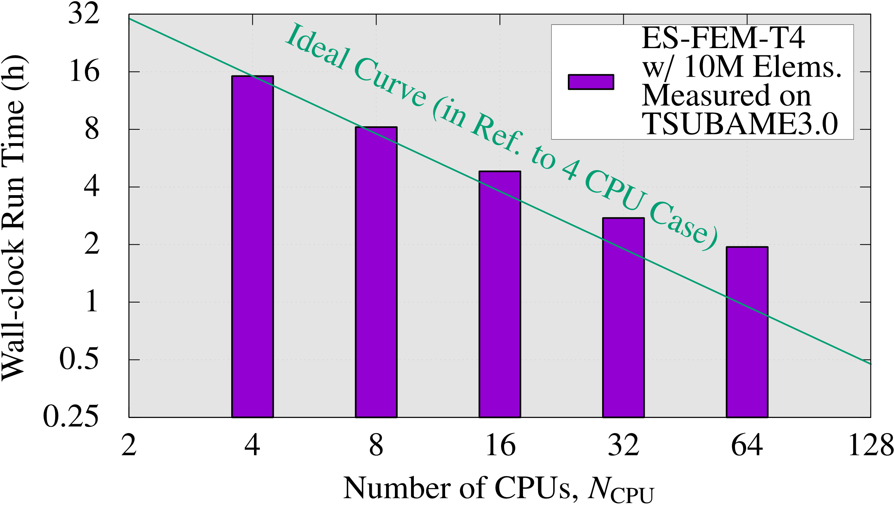
Actual Line Analysis
Strong Scaling Test (with 10M Element Mesh)
On a cluster (up to 64 CPUs: 896 cores of Intel Xeon E5-2680 v4 on TSUBAME3.0)
EDESFEM scales to some extent up to 64 CPUs at least.

Slide 33
EDESFEM
Validation Example 1
4-Plate Box Test/Simulation

Slide 34

4-Plate Box Test/Simulation
Overview
Plates(Cathode)
Box
Paint
Cylibder
(Anode)
Spacer
Spacer
Spacer
Constant-Temp.
Water Bath
Overall view
The Box

Slide 35
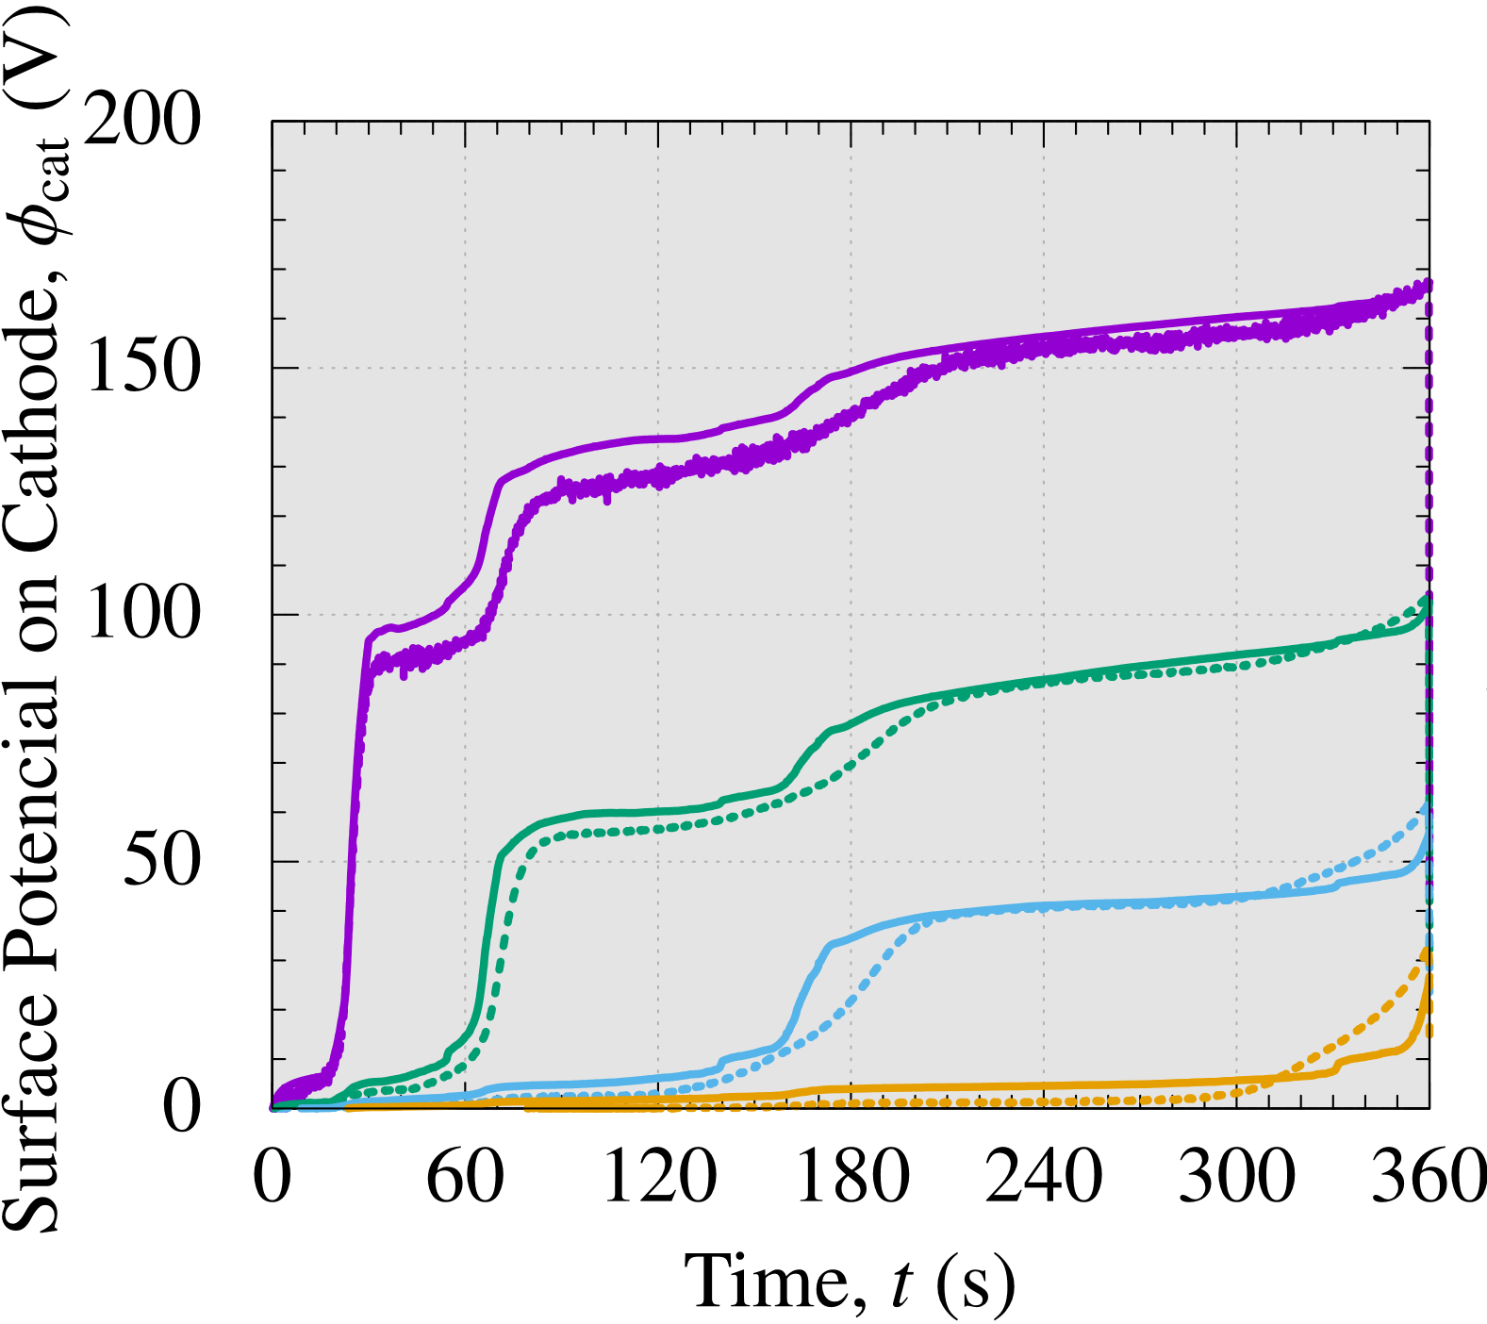
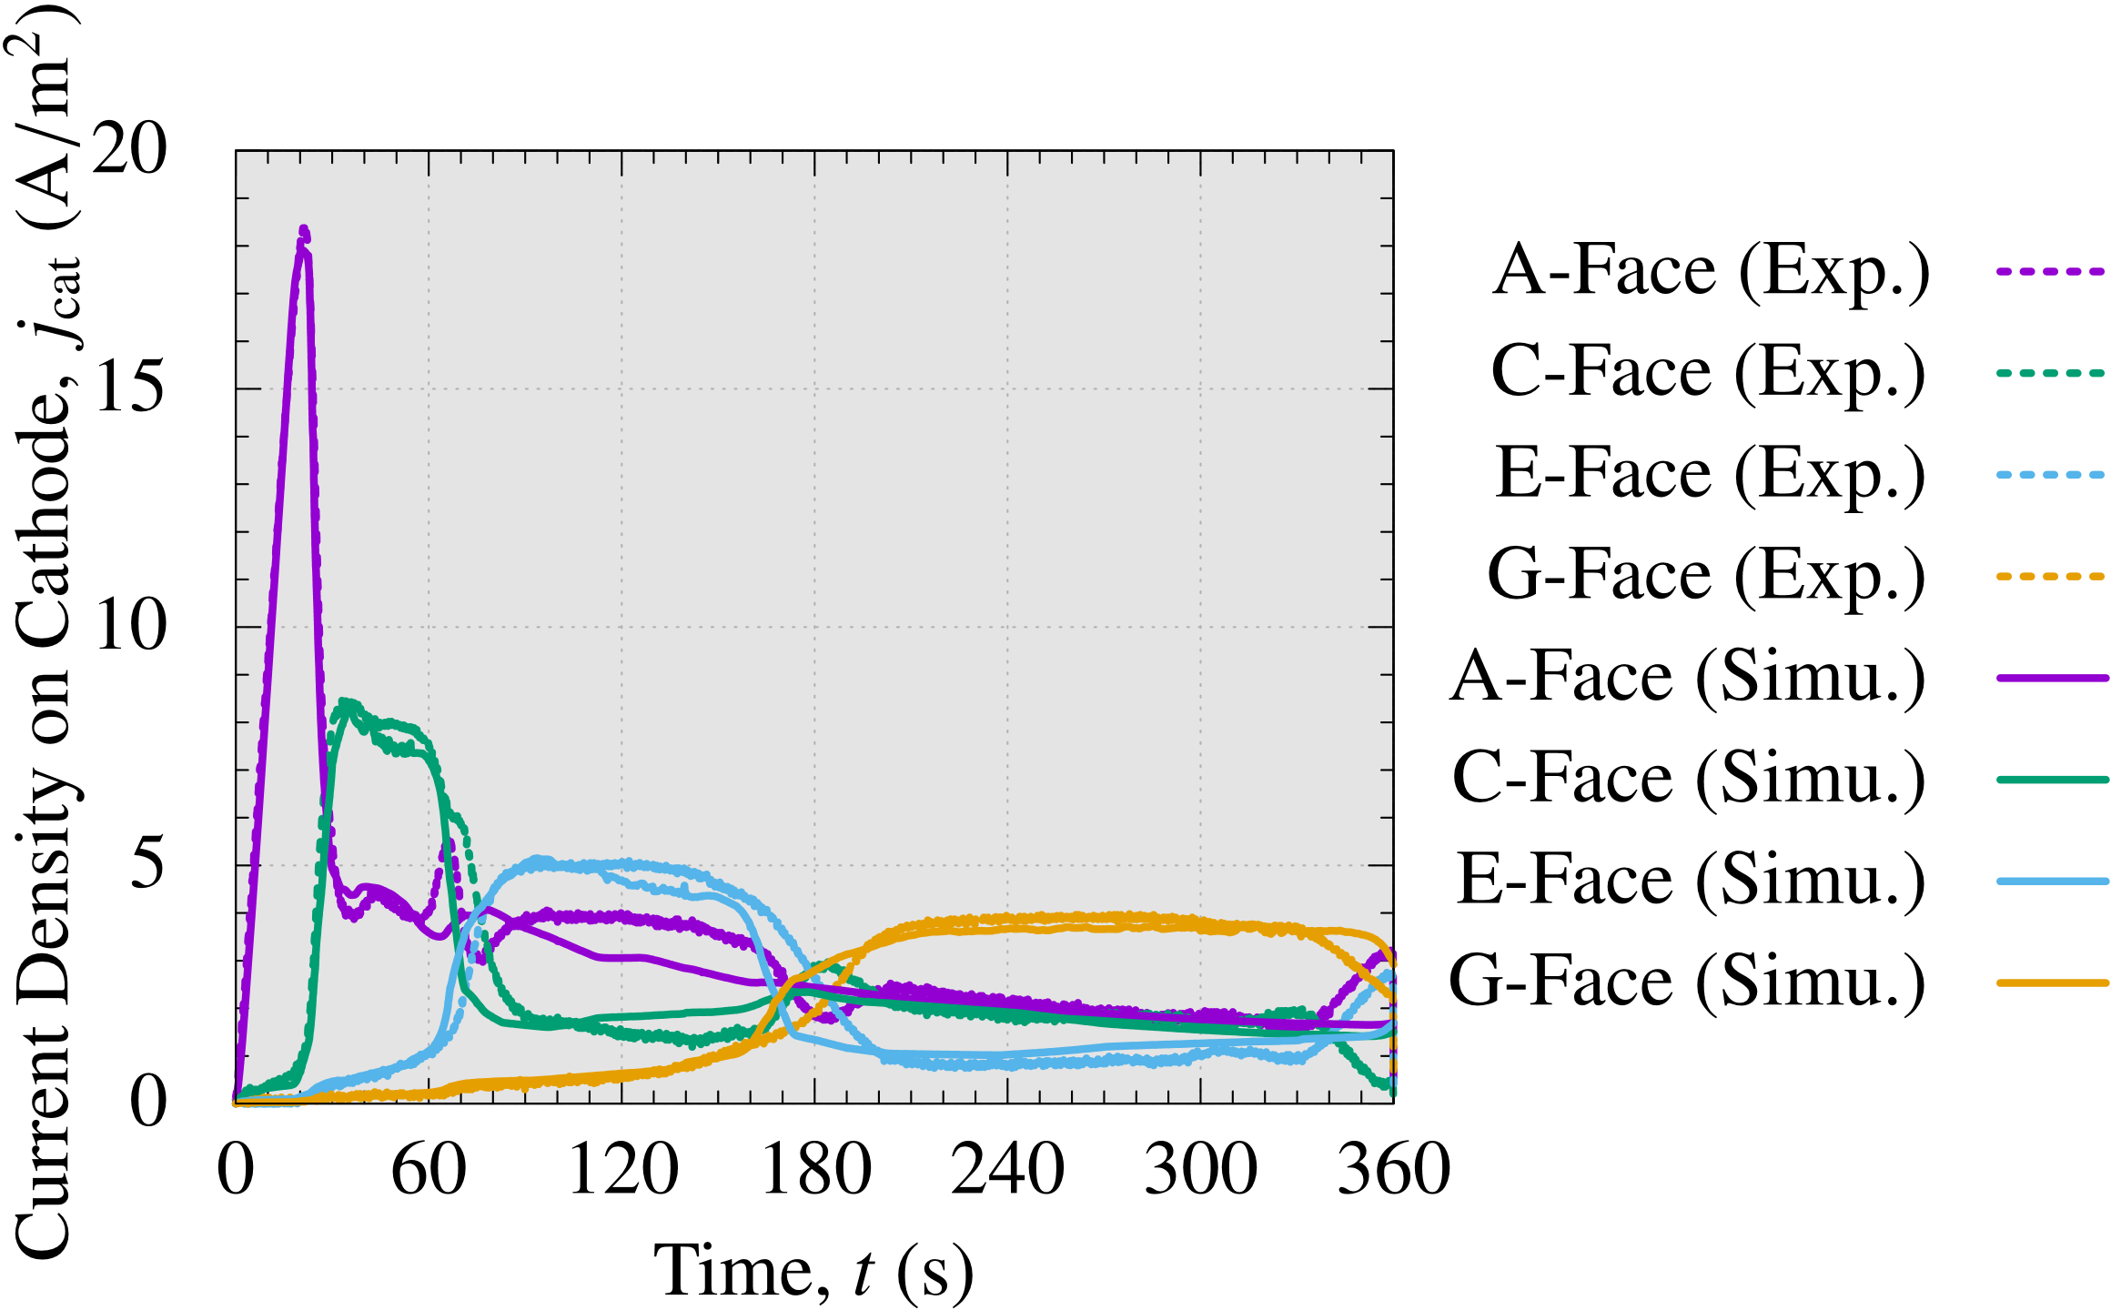
4-Plate Box Test/Simulation
Validation of Surface Potential (left) and Current Density (right)
The simulated results are agreed with the experiment results
in practical accuracy.

Slide 36
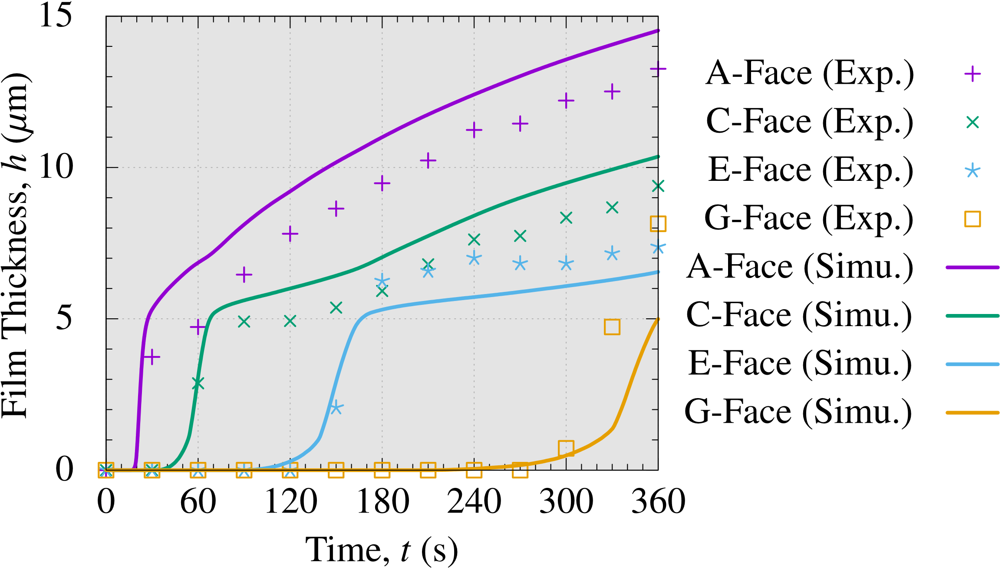
4-Plate Box Test/Simulation
Validation of Film Thickness
Although the accuracy of the innermost surface (G-Face) remains an issue (maximum error of 3 μm), the accuracy of the other surfaces
is practically enough (less than 2 μm error).

Slide 37
EDESFEM
Validation Example 2
Actual Line Test/Simulation

Slide 38
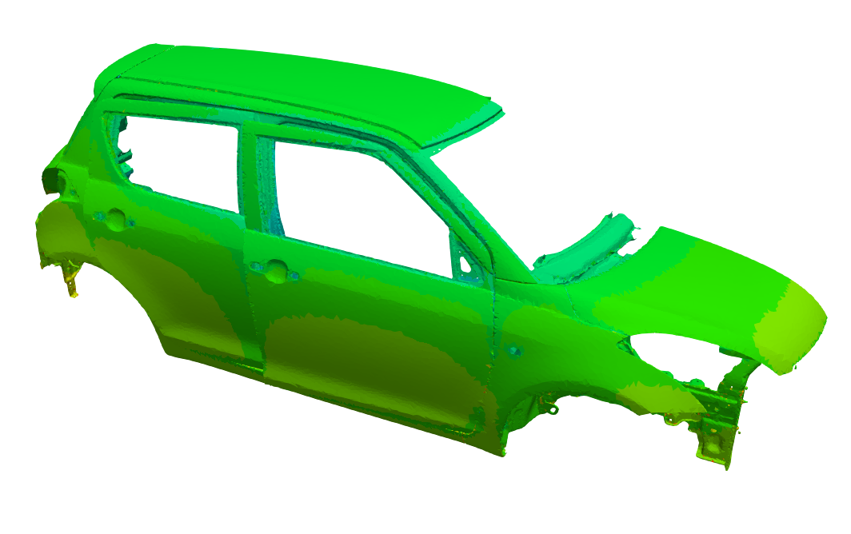

Actual Line Test/Simulation
Outline $∎$ Measured 6 Points
Test
A surface potential measurement device with 6 probes was mounted
on a car running on an actual line to measure surface potential.
After baking, the film thickness was measured at the 6 points.
Simulation
Half-body analysis considering the right-hand side of the pool and car.
Shapes of the pool, electrodes, and carbody with motion are reproduced.
Surface potential time histories and final film thickness at the 6 points are compared.
Ch.7：Back Door
Ch.4：Roof
●
●
Ch.2：Hood
●
●
●
Ch.3：Side Door
Ch.5：Side Sill
Ch.6：Floor
(not visible on this Fig.)

Slide 39
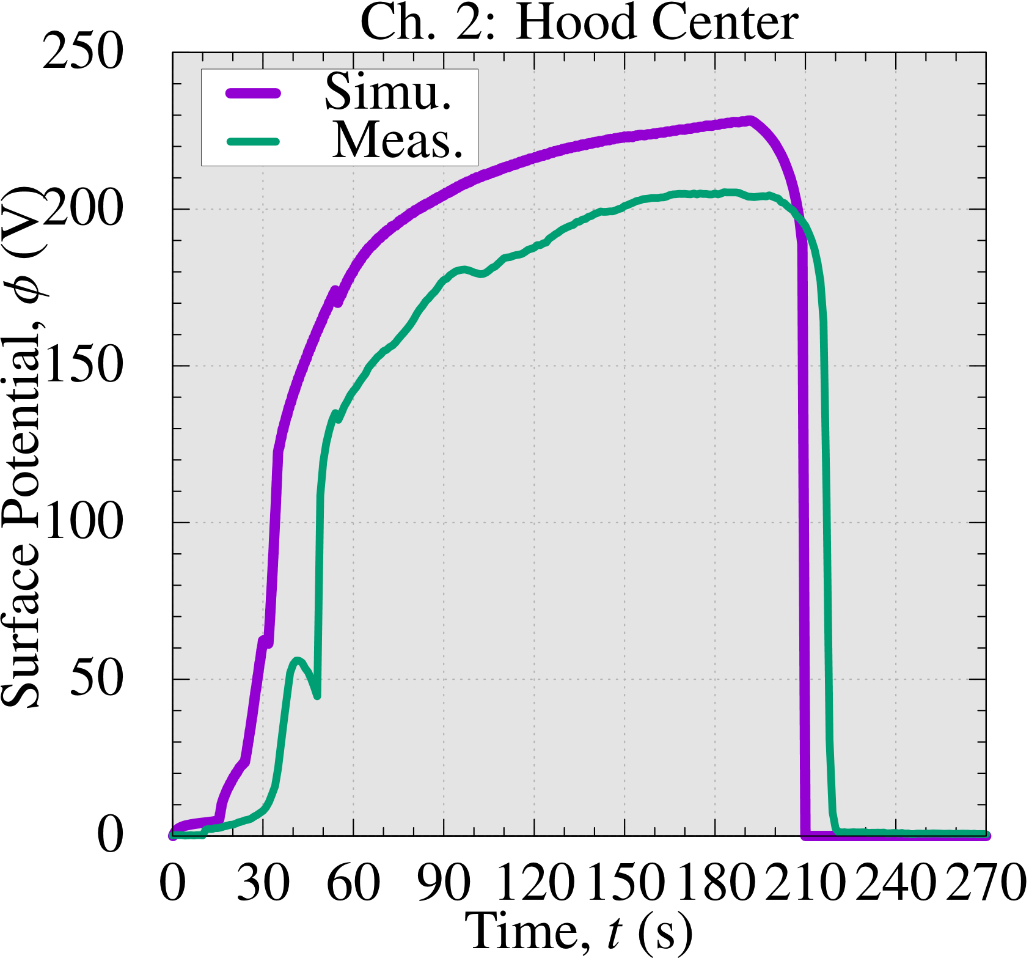
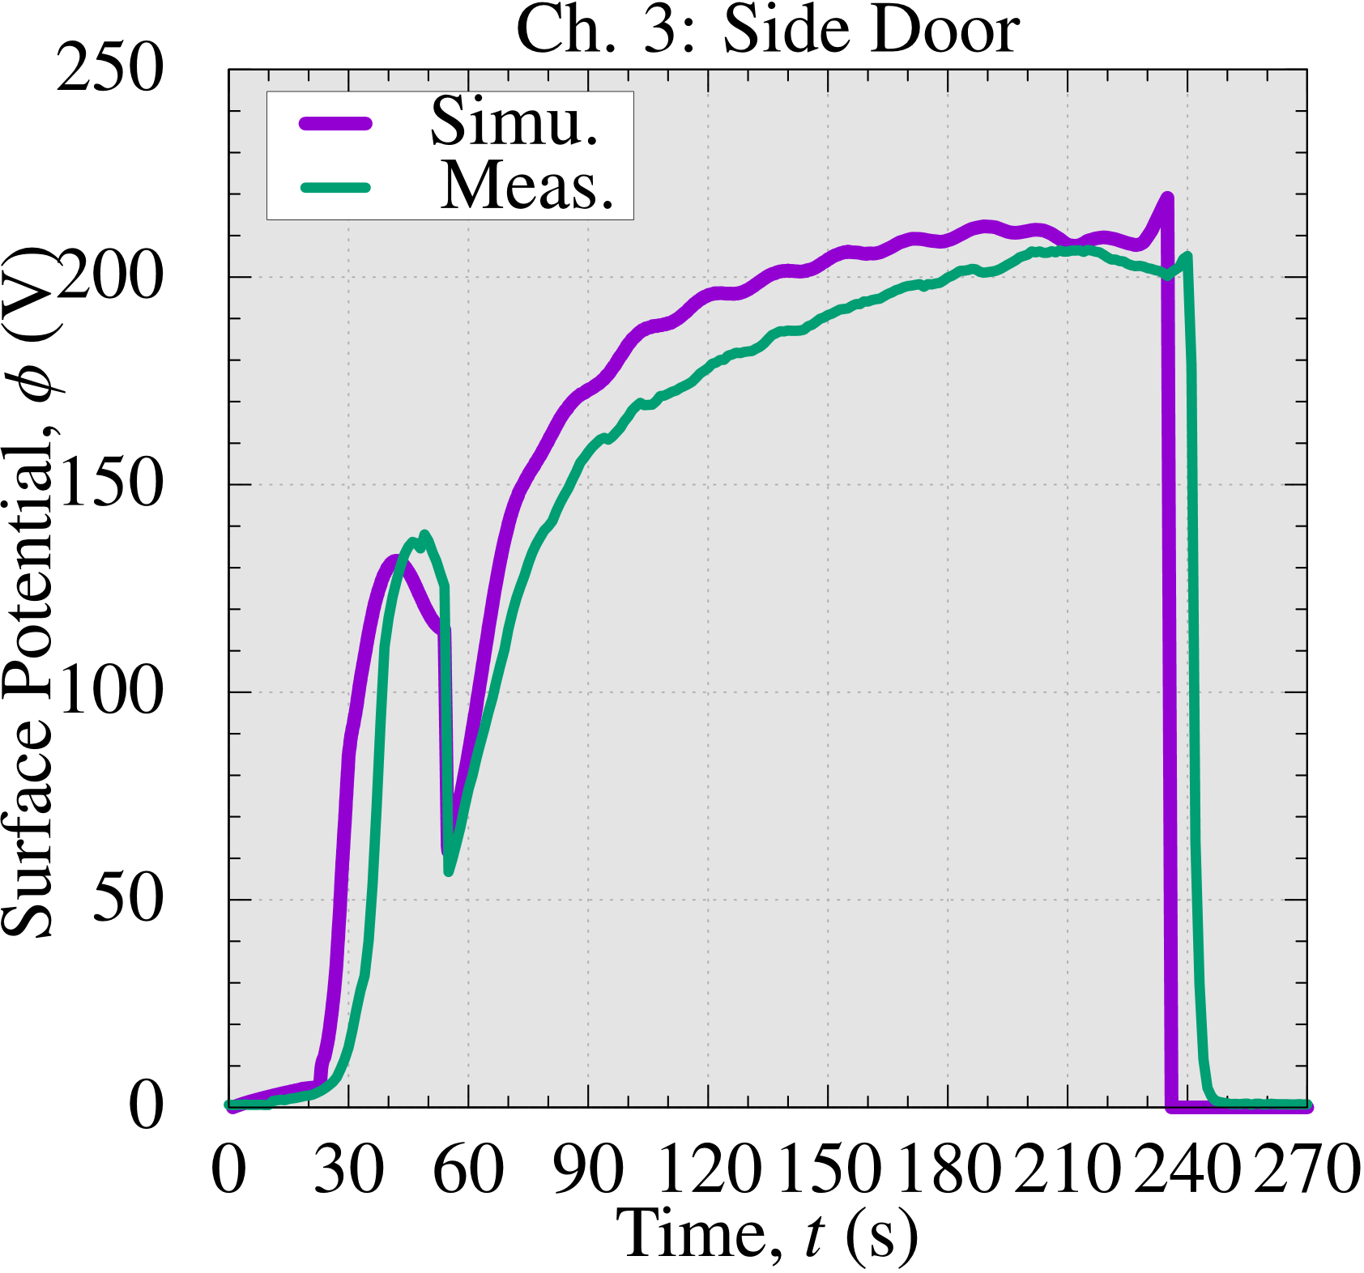
Actual Line Test/Simulation
Validation of Surface Potential (Ch. 2 and 3)
The simulated surface potential is a little high
because the degradation of the membranes of electrodes was not precisely simulated;
yet, the results generally agree with practical accuracy.

Slide 40


Actual Line Test/Simulation
Validation of Surface Potential (Ch. 4 and 5)
The simulated surface potential is a little high
because the degradation of the membranes of electrodes was not precisely simulated;
yet, the results generally agree with practical accuracy.

Slide 41


Actual Line Test/Simulation
Validation of Surface Potential (Ch. 6 and 7)
The deposition delay at the
floor, an inner part, is reproduced successfully.
The simulated surface potential is a little high
because the degradation of the membranes of electrodes was not precisely simulated;
yet, the results generally agree with practical accuracy.

Slide 42


Actual Line Test/Simulation
Validation of Film Thickness
Point | Measured ($μm$) | Simulated ($μm$) | Error ($μm$)
Ch.2: Hood | 20.1 | 21.4 | $+1.3 (+6.5\%)$
Ch.3: Side Door | 19.0 | 21.0 | $+2.0 (+10.5\%)$
Ch.4: Roof | 17.0 | 19.3 | $+2.3 \left(+13.5\%\right)$
Ch.5: Side Sill | 20.0 | 21.6 | $+1.6 (+8.0\%)$
Ch.6: Floor | $$−$$ | 14.5 | $$−$$
Ch.7: Back Door | 23.0 | 20.3 | $−2.7 (−11.7\%)$
Although there is still room for improvement in accuracy,
the maximum error in film thickness is less than 3 $μm$,
which is accurate enough for practical use.

Slide 43
EDESFEM
Summary

Slide 44

Summary
The electrodeposition simulator “EDESFEM” is now on sale.
4 features of the software were introduced:
  High Accuracy with 4-node Tetrahedral Meshes,
  Support for Moving Boundary Analysis of Multiple Bodies,
  High Speed with MPI/OpenMP Hybrid Parallelization,
  Faithful Reproduction of Deposition Delay on Inner Plates.
V&Vs for the 4-plate box and an actual line were presented.
Search
edesfem
Leaflet is
also available!
Please feel free to contact us at the following e-mail address
for trial or purchase of EDESFEM or for any questions.
We also welcome your inquiries about ED lab experiments and actual line measurements.
edesfem@rccm.co.jp

